Slide 1
Cyberbullying
Cyber Bullying (UNICEF)
Cyber Bullying (UNICEF)
A decade-long battle

Slide 2
What is Cyberbullying ?

Slide 3
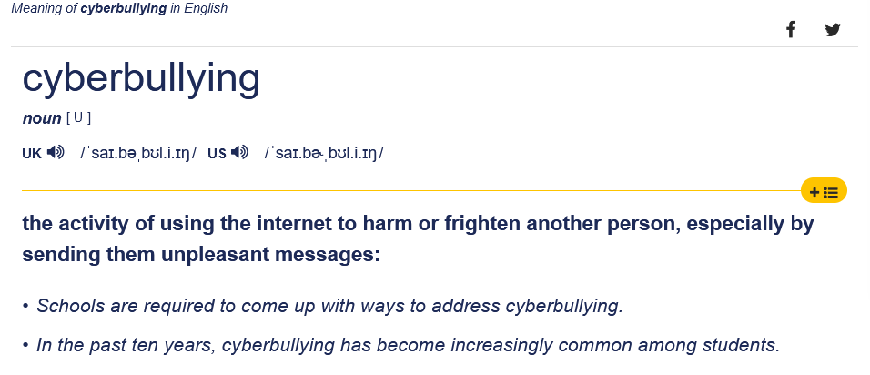
Cyberbullying : definition

Slide 4
Video : Cyber Bullying (UNICEF)

Slide 5
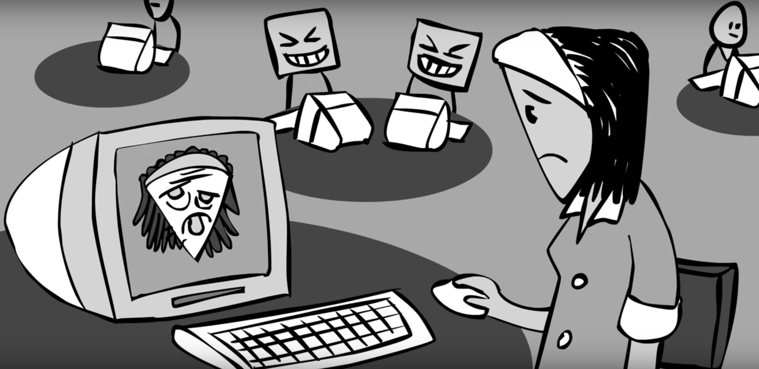
What ? What about ?

Slide 6
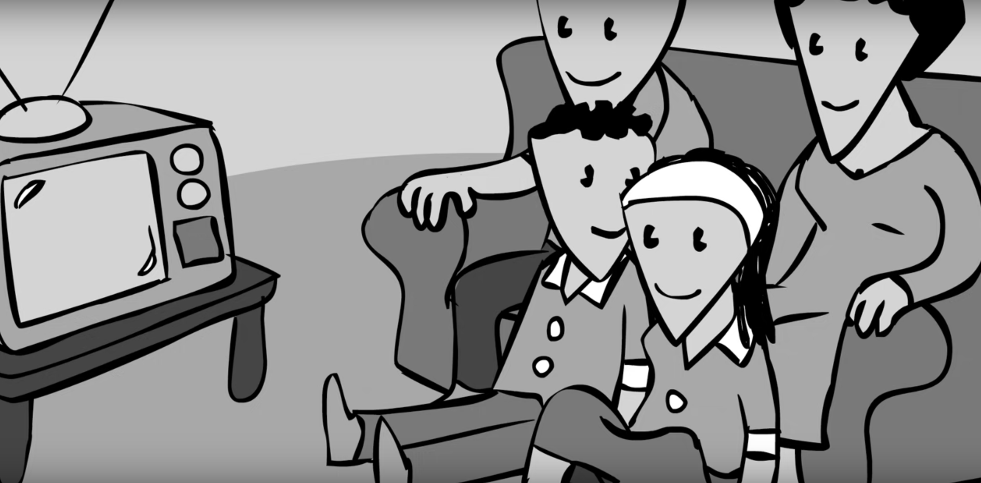
Analysis and viewpoint

Slide 7
Who is targeted ?

Slide 8
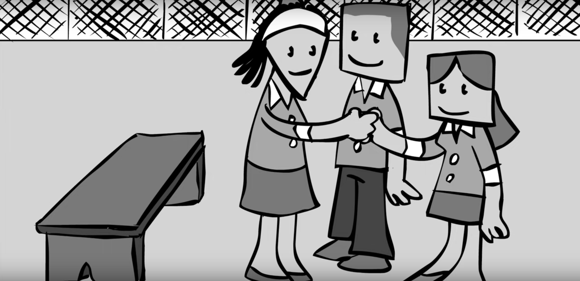
Who is targeted ?

Slide 9
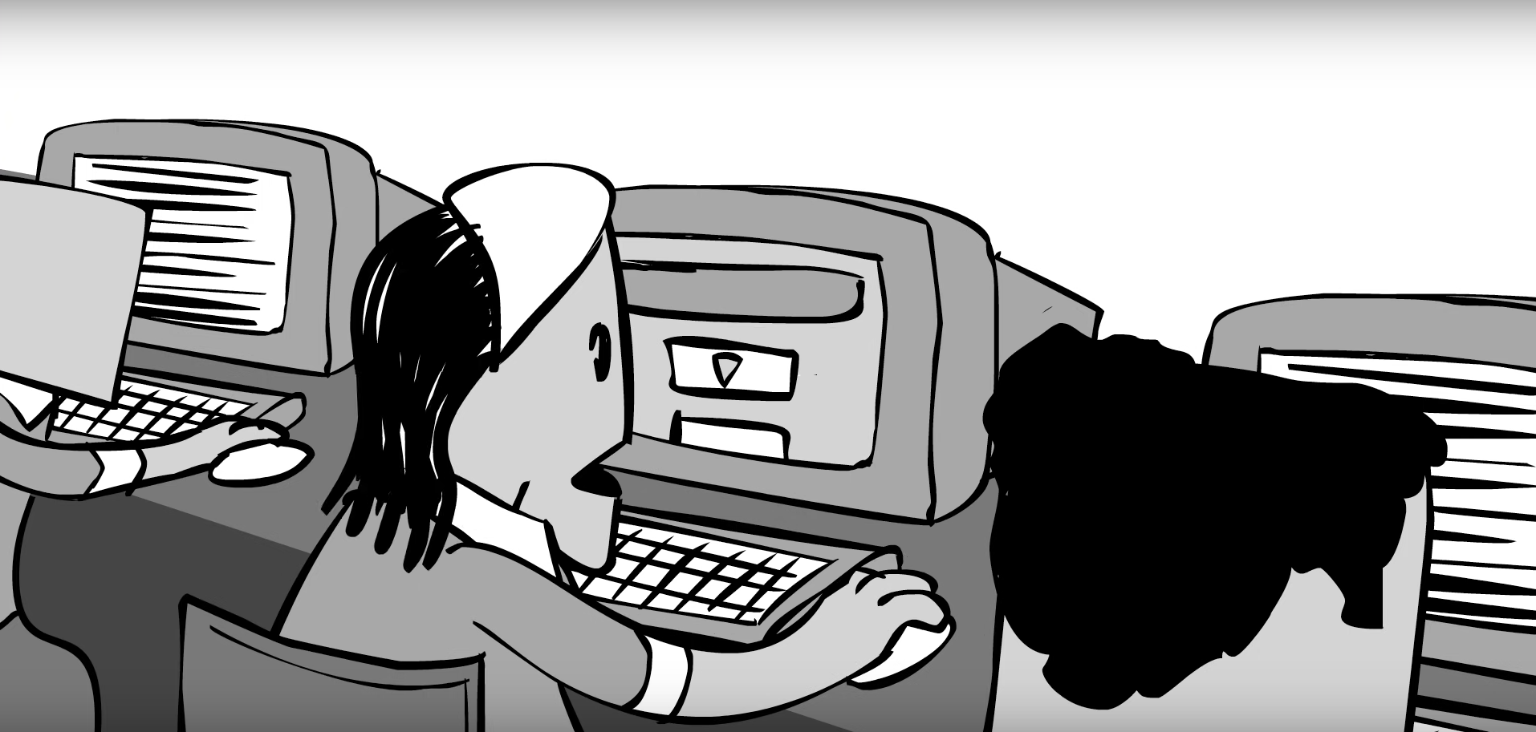
Image and audio

Slide 10
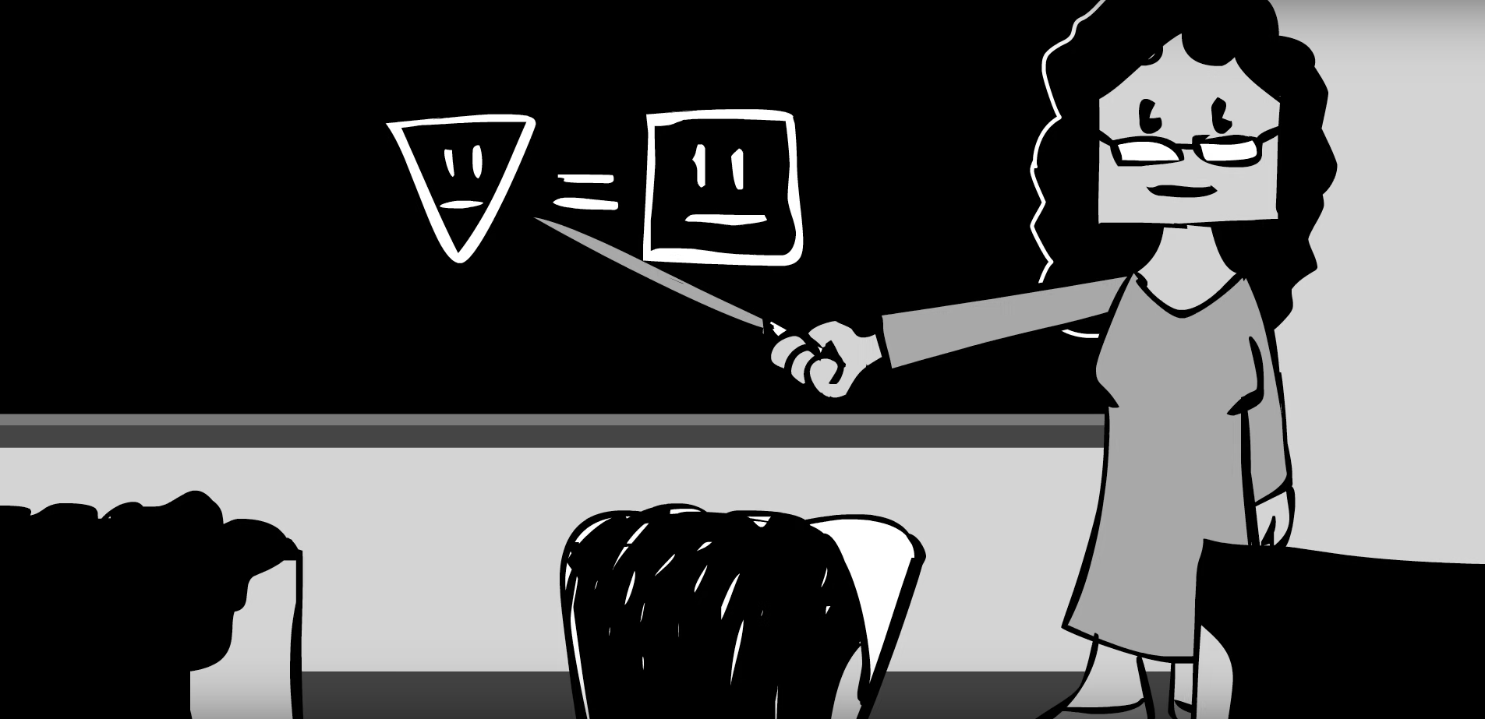
Keys to handle Cyberbullying

Slide 11
Is it effective ?

Slide 12

Is it effective ?

Slide 13
Changes on the video ?
Put some color

Slide 14

How to prevent Cyberbullying ?

Slide 15
Some numbers
How many children have been affected by Cyberbullying ?
14 % answer « Yes » when asked if they’ve been bullied (Using this term)
17 % answer

Slide 16
Some numbers
The average profile
13 years old
Mainly girls
More equipped
More connected

Slide 17
How to prevent Cyberbullying ?
If you are a victim, talk
If you are a witness, talk
If you are a parent, watch on kids
Dont stay silent

Slide 18
Sources
VIDEO : Cyber Bullying (UNICEF)
Definition Cyberbullying (Cambridge Dictionnary)
Numéro d’écoute (www.e-enfance.org)

Slide 19
Thanks for listening !

